Slide 1
Concept of Heap and Stack in .net variable assignment

Slide 2
What goes inside when you declare a variable?
Allocates some chunk of memory in the RAM.
This memory has three things: the name of the variable, the data type of the variable, and the value of the variable.
Depending on the data type, your variable is allocated that type of memory.
There are two types of memory allocation: stack memory and heap memory.

Slide 3
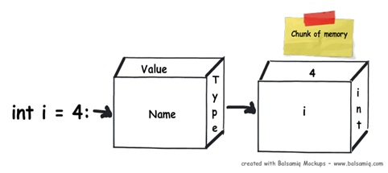

Slide 4
Stack and Heap
public void Method1()
{
// 1
int i=4;
// 2
int y=2;
// 3
class1 cls1 = new class();
}

Slide 5
It’s a three line code, let’s understand line by line how things execute internally.
1: When this line is executed, the compiler allocates a small amount of memory in the stack. The stack is responsible for keeping track of the running memory needed in your application.
2: Now the execution moves to the next step it stacks this memory allocation on top of the first memory allocation. Memory allocation and de-allocation is done using LIFO (Last In First Out) logic. In other words memory is allocated and de-allocated at only one end of the memory, i.e., top of the stack.
3: In line 3, we have created an object. When this line is executed it creates a pointer on the stack and the actual object is stored in a different type of memory location called ‘Heap’. ‘Heap’ does not track running memory, it’s just a pile of objects which can be reached at any moment of time. Heap is used for dynamic memory allocation.
One more important point to note here is reference pointers are allocated on stack. The statement, Class1 cls1;does not allocate memory for an instance of Class1, it only allocates a stack variable cls1 (and sets it to null). The time it hits the new keyword, it allocates on "heap".

Slide 6
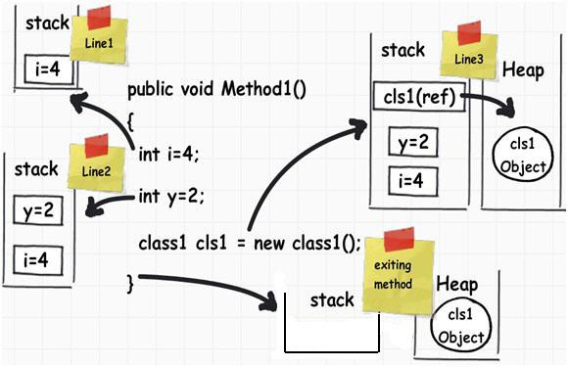

Slide 7
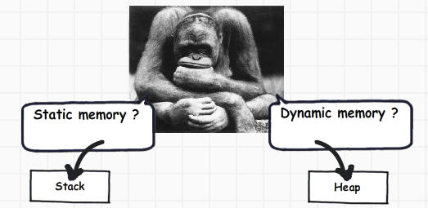

Slide 8
Value types and reference types
Value types are types which hold both data and memory on the same location.
A reference type has a pointer which points to the memory location.
A simple integer data type with name i whose value is assigned to another integer data type with name j.
When we assign the int value to the other int value, it creates a completely different copy.
In other words, if you change either of them, the other does not change.
These kinds of data types are called as ‘Value types’.

Slide 9
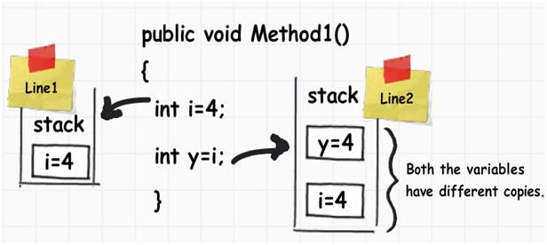

Slide 10
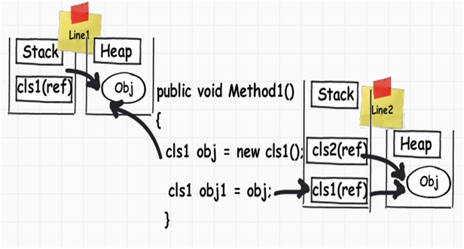
when we assign an object to another object, they both point to the same memory

Slide 11
So which data types are ref types and which are value types?

Slide 12
Tasks
WAP to assign value to meaningful variables of data types int, float ,char, String, bool ,double.
WAP program using bool and check the condition if true print you are Asian BIM student else you are CSIT student.
Print size and min and max value of byte, long and double.

